Slide 1
Multiple Linear Regression on Diamond Dataset
Sricharan Mamidi – 101030145
AIDI 1002 – AI Algorithms
Professor: Sam Plati

Slide 2
Objective & Dataset
• Goal: Predict diamond price using multiple regression
• Dataset: 53,940 rows, 10 variables
• Dependent Variable: Price (USD)
• Independent Variables: Carat, Cut, Color, Clarity, Depth, Table, x, y, z
• Categorical variables (Cut, Color, Clarity) encoded using OneHotEncoder

Slide 3
Regression Model Equation
Price = 3945.97 + 5423.17(carat) - 91.83(depth) - 58.17(table) - 1190.32(x) + 5.33(y) - 50.84(z) + ...
Note: The model also includes categorical effects for Cut, Color, and Clarity.

Slide 4
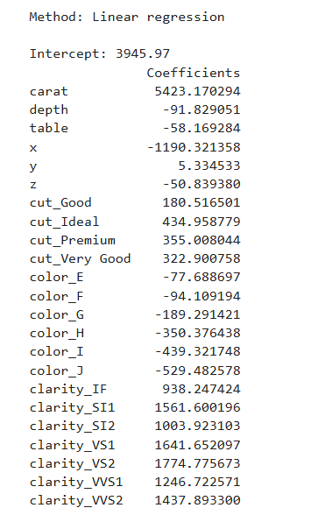
Full Coefficient table

Slide 5
Interpretation of Coefficients
• Carat (+5423): Strongest positive impact; higher carat increases price.
• Cut: Better cuts (Ideal, Premium, Very Good) increase price vs Fair.
• Color: Negative coefficients (E–J) vs D show lower-quality color reduces price.
• Clarity: Higher clarity grades (VS2, VS1, etc.) increase price significantly.
• x dimension: Negative effect, possible multicollinearity with carat.

Slide 6
Model Performance Metrics
• R² = 0.92, Adjusted R² = 0.92 → Model explains ~92% of price variation
• MAE = 732.62 USD → Avg. error in predictions
• RMSE = 1133.33 USD → Typical error magnitude
• MSE = 1,284,446.80 USD² → Squared error (less intuitive)

Slide 7
Conclusion
• Strong regression model with 92% accuracy.
• Carat is the most influential predictor of diamond price.
• Cut, clarity, and color also significantly impact pricing.
• Errors are small compared to average prices.
• Model is reliable for forecasting diamond prices.

